Slide 1
VIPS: a Vision-based Page Segmentation Algorithm
Deng Cai, Shipeng Yu, Ji-Rong Wen, Wei-Ying Ma
2003 Microsoft Research TechReport
Microsoft Research Asia
College of Computer Science at Zhejiang University
Institute for Computer Science, University of Munich (LMU)
July 6, 2011
Heegook Jun

Slide 2

Analyzing the visual aspect of web pages
Simulates how a user understands the changes based on his visual perception
Preserving the visual aspect of web pages gives more relevant information to understand

Slide 3
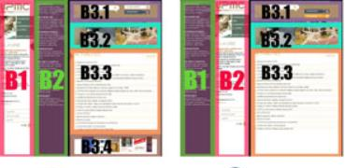
“Vi-DIFF” Method to compare pages
Compares two web pages in three steps
(1) Segmentation: web page → visual semantic blocks
(2) Change detection
(3) Delta file generation: describe the visual changes
Input (Segmentation)
Change Detection
Output (Delta File)
D
D
<xml>
<Delta FROM="V1" TO="V2">
<Delete>
<Block Ref="B3.4" />
</Delete>
<Block Ref="B2" newRef="B1" />
<Block Ref="B1" newRef="B2" />
<Block Ref="B3.1">
<Delete>
<link Name="MON UPMC"
Adr="upmc.html"/>
</Delete>
<Insert>
<link Name="ACCES DIRECT"
Adr="direct.html"/>
</Insert>
</Block>
</Delta>
</xml>
B1
B2
B3
B1
B2
B3
B3.1
B3.2
B3.3
B3.4
B3.1
B3.2
B3.3
Links
Links
link
link

Slide 4
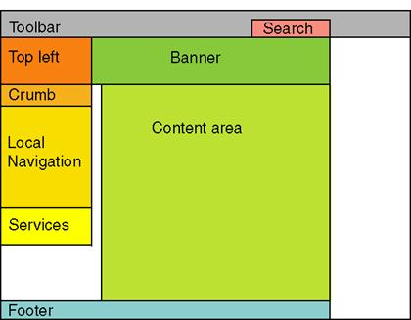

Segmentation
Detects horizontal and vertical separators of the page
Constructs the visual tree partitioned into multiple blocks
VIPS !!

Slide 5
Primary Objective
Algorithm to semantically segment the web page
VIPS Algorithm

Slide 6
Outline
Introduction
Related Work
Vision-based Content Structure for Web Pages
The VIPS Algorithm
Experiments
Conclusion

Slide 7

Outline
Most information retrieval systems on the Web consider web pages as the smallest and undividable units
Web page often contains multiple topics that are not necessarily relevant to each other

Slide 8
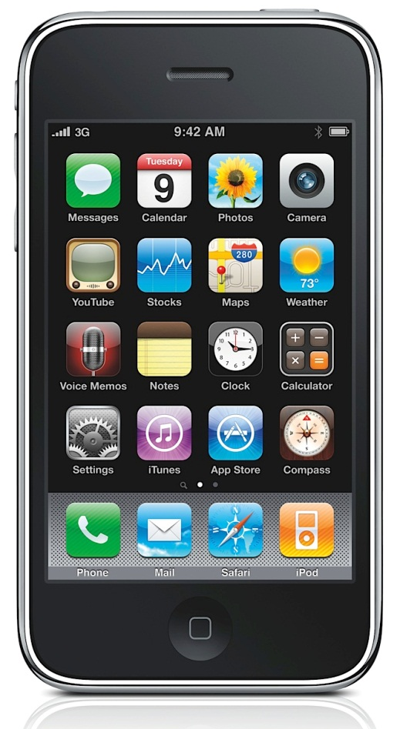
Outline
Detecting the semantic content structure of a web page could improve the performance of web information retrieval
And efficient browsing of large web pages on small handheld devices also necessitates semantically segmentation

Slide 9
Outline
Much recent work try to extract the structure information from HTML DOM tree
However, because of the flexibility of HTML syntax
a large amount of web pages do not obey the W3C html specifications, which might cause mistakes in DOM tree structure
Moreover, DOM tree is initially introduced for presentation in the browser rather than description of the semantic structure of the web page

Slide 10
Outline
In the sense of human perception, it is always the case that people view a web page as different semantic objects rather than a single object
We propose VIPS(Vision-based Page Segmentation) algorithm to extract the semantic structure for a web page

Slide 11
Outline
Introduction
Related Work
Vision-based Content Structure for Web Pages
The VIPS Algorithm
Experiments
Conclusion

Slide 12
Related Work
Many researchers have considered using the tag information and dividing the page based on the type of the tags
<p>, <TABLE>, <UL>, <H1> ~ <H6>
Diao, Kaasinen, Buyukkokten
Some other alogrithms also make use of the content or link information
Embley, Buttler, Chakrabarti, Bar-Yossef

Slide 13
Related Work
FOM(Function-based Object Model) is proposed by Chen for content understanding and adaptation
Function type can be defined to each object and helps to build a hierarchical structure for the page
However, the grouping rules and the functions are hard to define accurately, and thus make the whole process very inflexible
All of the above methods fail to take into account visual structure of the web page
We propose a new algorithm VIPS
To semantically segment the web page

Slide 14
Outline
Introduction
Related Work
Vision-based Content Structure for Web Pages
The VIPS Algorithm
Experiments
Conclusion

Slide 15
Vision-based Content Structure
We define the basic object as the leaf node in the DOM tree that can not be decomposed any more
We propose the vision-based content structure, where every node, called a block, is a basic object or a set of basic objects
The nodes in the vision-based content structure
do not necessarily correspond to the nodes in the DOM tree

Slide 16


VIPS Process
DOM Tree
VIPS
Tree of Blocks
(vision-based
content structure)
Visual Info

Slide 17
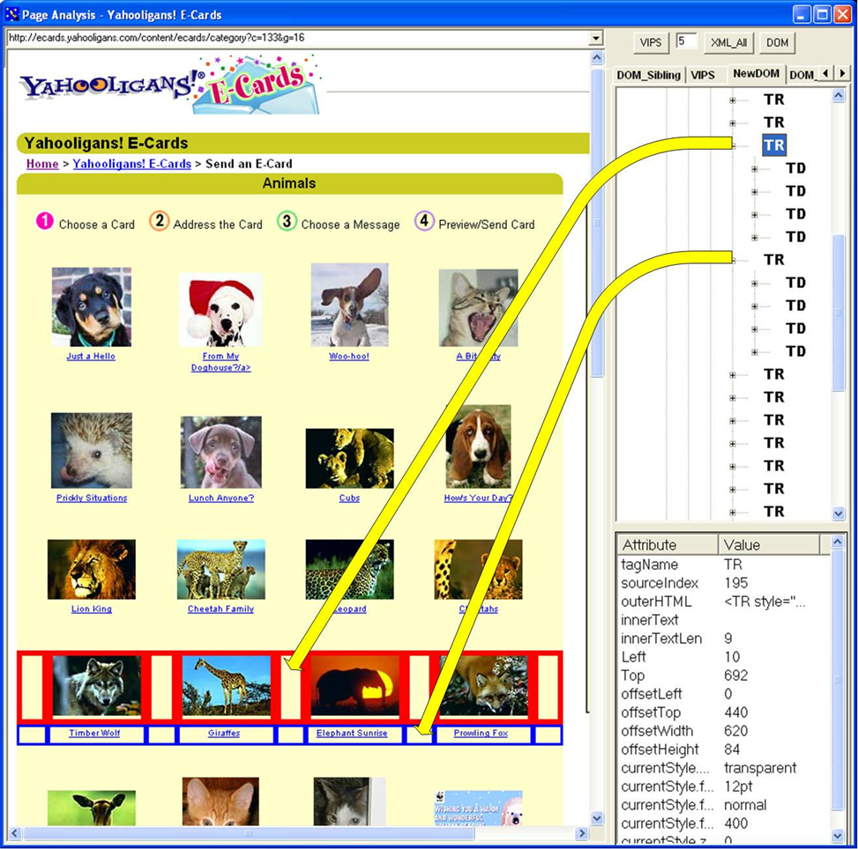
Traditional Segmentation vs Sementic Block

Slide 18
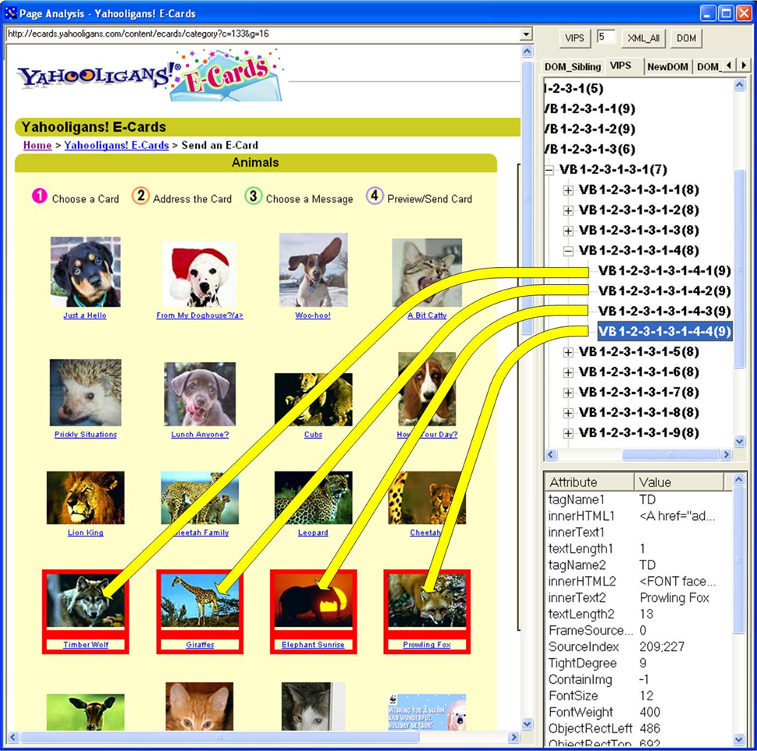
Traditional Segmentation vs Sementic Block

Slide 19
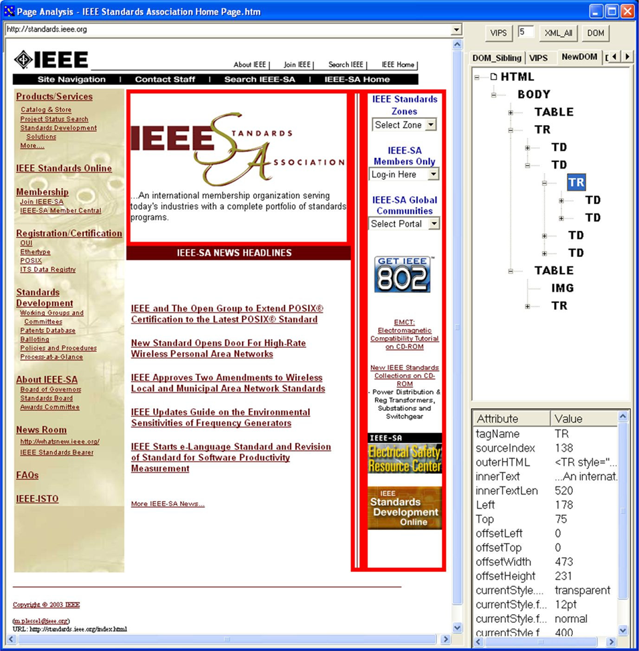
Traditional Segmentation vs Sementic Block

Slide 20
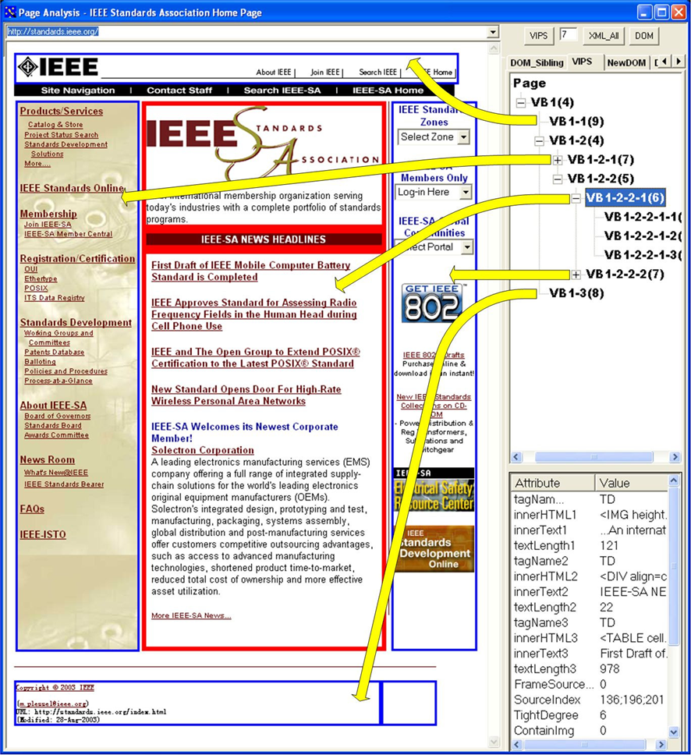
Traditional Segmentation vs Sementic Block

Slide 21
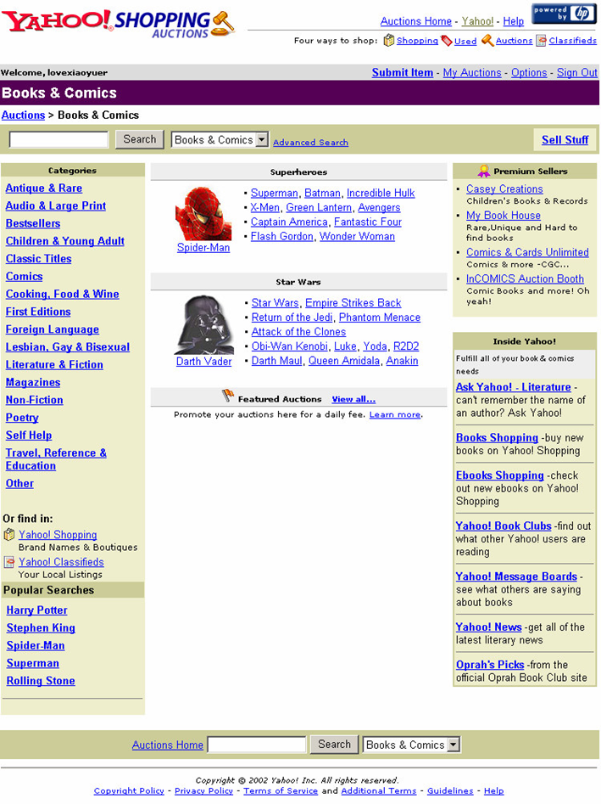
VIPS Process1: Visual Block Extraction
VB1
VB2
O = (VB1, VB2, VB3, VB4)
VB3
VB4

Slide 22
VIPS Process2: Visual Separator Detection
VB1
Separator1
(VB1, VB2) φ1
(VB2, VB3) φ2
(VB3, VB4) φ3
else NULL
VB2
Φ = (φ1, φ2, φ3)
δ =
Separator2
VB3
Separator3
VB4

Slide 23
VIPS Process: Recursive Segmentation
VB1
Separator1
VB2-1
VB2-2
VB2
VB2-3
Separator2-1
Separator2-2
Separator2
VB3
Separator3
VB4

Slide 24
VIPS Process3: Content Structure Construction
Page
VB1
VB2
VB3
VB2-1
VB2-2
VB2-3

Slide 25
DoC (Degree of Coherence)
Defined to measure how coherent it is
The greater the DoC value, the more consistent the content within the block
Child block > Parent block
Range 1 ~ 10
VB1
7
VB1
VB2
3
VB2-1
VB2-2
VB2-3
7
5
8
VB3
8
VB3
VB4
7
VB4

Slide 26

PDoC (Permitted Degree of Coherence)
To achieve different granularities of content structure for different applications

Slide 27
Permitted Degree of Coherence
Control degree of segmentation by PDoC
PDoC = 1
PDoC = 3
PDoC = 4
VB1
7
VB1
VB0
1
VB2
3
VB2-1
VB2-2
VB2-3
7
5
8
VB3
8
VB3
VB4
7
VB4

Slide 28
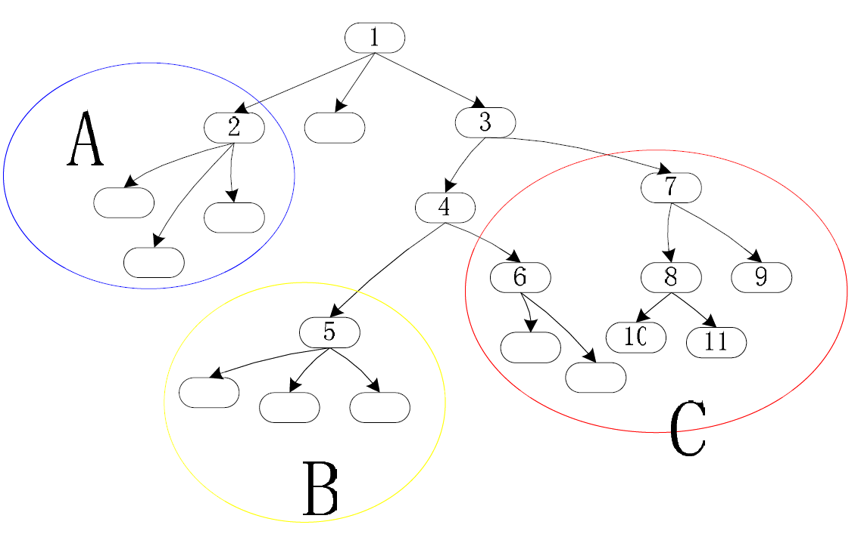
DOM Tree vs Semantic Block Tree
DOM Tree
Semantic Block Tree
Page
VB1
VB2
VB3
VB2-1
VB2-2
VB2-3

Slide 29
Outline
Introduction
Related Work
Vision-based Content Structure for Web Pages
The VIPS Algorithm
Experiments
Conclusion

Slide 30
VIPS Algorithm
DOM Tree
VIPS
Tree of Blocks
(vision-based
content structure)
Visual Info

Slide 31
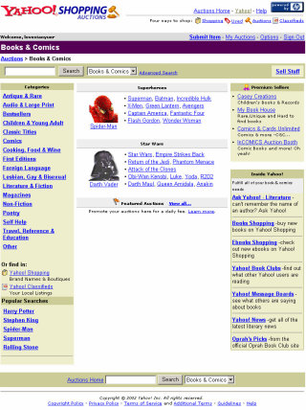
VIPS Algorithm
I. Visual
Block
Extraction
II. Visual
Separator
Detection
III. Content
Structure
Construction
VB2-1
VB2-2

Slide 32
4.1 Visual Block Extraction
Block extraction by “Divide” during traverse the DOM tree
DOM node can be divided based on,
Properties of the DOM node itself (background color, size, shape..)
Properties of the children of the DOM node
[Tag Cue] line-break node(<HR>..) → Divide
[Color Cue] red|red|blue|red → Divide
Heuristic Rules
In block extraction phase
[Text Cue] text|virtual text → Not Divide
<b>I’m a boy</b>
[Size Cue] small than the threshold → Not Divide

Slide 33

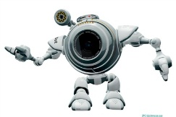
4.1 Visual Block Extraction
Rule2: If the DOM node has only one valid child and the child is not a text node, then divide this node
table
td
table
table
Divide!
td
table
table
tr
td
center
table
table
td
table
td
table
table

Slide 34
4.1 Visual Block Extraction
Rule8: If the bg color of this node is different from one of its children’s, divide this node and at the same time, the childe node with different bg color will note be divided in this round
table
Do Not Divide,
Put into pool as block!
td
table
VB2-1
Divide!
table
td
table
table
tr
td
center
table
table
td
table
td
table
table

Slide 35
4.1 Visual Block Extraction
Rule1: If the DOM node is not a text node and it has no valid children, then this node cannot be divided and will be cut
table
Cut!
td
table
VB2-1
table
td
table
table
tr
td
center
table
table
td
table
td
table
table

Slide 36
4.1 Visual Block Extraction
Rule11: If previous sibling node has not been divided, do not divide this node
table
Do Not Divide,
Put into pool as block!
td
table
VB2-1
table
td
table
1
table
tr
td
center
table
VB2-2
table
td
table
td
table
table

Slide 37
4.1 Visual Block Extraction
Rule1: If the DOM node is not a text node and it has no valid children, then this node cannot be divided and will be cut
table
td
table
VB2-1
table
td
table
1
table
tr
td
center
table
VB2-2
Cut!
table
td
table
td
table
table

Slide 38
4.1 Visual Block Extraction
Rule11: If previous sibling node has not been divided, do not divide this node
table
td
table
VB2-1
table
td
table
1
table
tr
td
center
table
VB2-2
table
td
table
td
table
VB2-3
Do Not Divide,
Put into pool as block!
table

Slide 39
4.1 Visual Block Extraction
VB1
VB2-1
VB2-2
VB2
VB2-3
VB3
VB4

Slide 40
VIPS Algorithm
I. Visual
Block
Extraction
II. Visual
Separator
Detection
III. Content
Structure
Construction
VB2-1

Slide 41
4.2 Visual Separator Detection
Separator detection by “Split” using Block pool
1. Initialize the separator list
2. For every block in the pool, the relation of the block with each separator is evaluated
a) If the block is contained in the separator, split the separator
b) If the block crosses with the separator, update the separator’s parameters
c) If the block covers the separator, remove the separator

Slide 42
4.2 Visual Separator Detection
pool
Init Separator
1
2
4
3

Slide 43
4.2 Visual Separator Detection
Block is contained in the separator, split!
pool
S1
1
S2
2
4
3

Slide 44
4.2 Visual Separator Detection
Block is contained in the separator, split!
pool
S1
1
S2
2
4
S3
3

Slide 45
4.2 Visual Separator Detection
Block is contained in the separator, split!
pool
S1
1
S2
2
4
S3
3
S4

Slide 46
4.2 Visual Separator Detection
Block is crosses with the separator, update!
pool
S1
1
S2
2
4
S3
3
S4

Slide 47
4.2 Visual Separator Detection
Block covers the separator, remove!
pool
S1
1
S2
2
4
S3
3
S4

Slide 48
4.2 Visual Separator Detection
At the end, remove S1, S2! (border of the pool)
pool
S1
1
S2
2
4
3
S4

Slide 49
4.2 Visual Separator Detection
Setting weights for separators
Weight of a separator can be assigned based on the visual difference between its neighboring blocks
Title
text
text
text
text
text
text
content

Slide 50
VIPS Algorithm
I. Visual
Block
Extraction
II. Visual
Separator
Detection
III. Content
Structure
Construction
VB2-1
VB2-2

Slide 51
4.3 Content Structure Construction
The construction process starts from the separators with the lowest weight and the blocks beside these separators are merged to form new block
Merging process iterates till separators with maximum weights are met
The DoC of each new block is set based on the maximum weight of the separators in the block’s region

Slide 52
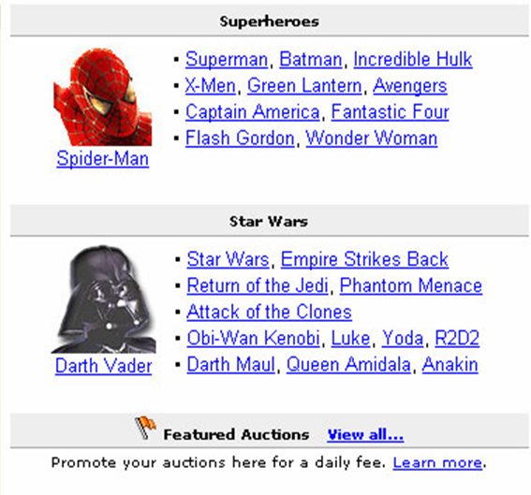
4.3 Content Structure Construction
Setting weights for separators
Weight of a separator can be assigned based on the visual difference between its neighboring blocks

Slide 53
4.3 Content Structure Construction
Setting weights for separators
Weight of a separator can be assigned based on the visual difference between its neighboring blocks

Slide 54
4.3 Content Structure Construction
Setting weights for separators
Weight of a separator can be assigned based on the visual difference between its neighboring blocks
Check granularity (DoC)
5
5
5
Check granularity (DoC)

Slide 55
Outline
Introduction
Related Work
Vision-based Content Structure for Web Pages
The VIPS Algorithm
Experiments
Conclusion

Slide 56
Performance of VIPS algorithm
Sample: 600 web pages from popular sites
VIPS is run on all the pages and the result are assessed by several individuals
1667+1124=2791 pages (93%) have their semantic content structures correctly detected
Human judgment | user1 | user2 | user3 | user4 | user5 | All
Perfect | 299 | 307 | 374 | 310 | 377 | 1667
Satisfactory | 231 | 266 | 193 | 2367 | 197 | 1124
Fair | 64 | 23 | 29 | 48 | 20 | 184
Bad | 6 | 4 | 4 | 5 | 6 | 25

Slide 57
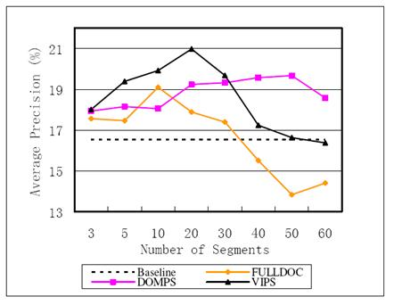
Experiments on web information retrieval
Traditional document approach
Simple DOM-based approach
Too short to cover complete information about a single semantic
Vision-based approach (VIPS)
Considers more visual information
More likely to obtain a semantic partition of a web page
About 27% performance improvement on the web track dataset was achieved

Slide 58
Outline
Introduction
Related Work
Vision-based Content Structure for Web Pages
The VIPS Algorithm
Experiments
Conclusion

Slide 59
Conclusion
A new approach for extracting web content structure based on visual representation
Very helpful for applications such as web adaptation, information retrieval and information extraction
By identifying the logic relationship of web content based on visual layout information
DOM Tree
VIPS
Tree of Blocks
(vision-based
content structure)
Visual Info

Slide 60
Thank You!
Any Questions or Comments?

